Slide 1
TRANSPARENT CHARITY APPLICATION USING BLOCKCHAIN
ALEENA PAUL
S4 mca a

Slide 2
RELEVANCE
Nowadays, people are becoming voracious to contribute to society. Many people want to donate generously for the causes they believe in but usually end up doing nothing due to no trust in the system around them. There are a lot of charitable organizations and NGOs that require funds now and then, which are working for the betterment of society.
We need a system that can decrease this fraud. Thus a new system is proposed to overcome this challenge.

Slide 3
DESCRIPTION
There are four types of users such as government, NGO, retailer, and users. Users can donate some amount to the respective work. Government can see donations for the proposal. This system will make the entire process more transparent.
We are using blockchain for a charity donation to make it more transparent. This Application provides trust between the users and donors. This helps resolve the trust issues, as people already know what they are pay.

Slide 4
OBJECTIVES
To to provide transparency to a charity application system.
To implement Blockchain in donation module

Slide 5
EXISTING SYSTEM
In existing charity applications everything is done manually, so it is very difficult to maintain the records. It’s also very difficult to find the activities. It is a Long-time process. It takes more time to prepare various events within a short time.
The biggest disadvantage of most NGOs there are exceptions is that they are not able to scale up their success. NGOs have many workers, and the effort they put in is considerable. But, when they succeed, it is often in a limited area. And, they cannot easily scale up.

Slide 6
PROPOSED SYSTEM
The proposed system uses blockchain technology for a charity donation to make it more secure.
To invest the public’s trust in government organizations or agencies.The lack of transparency in government activities could be solved technically with this blockchain charity system, which could increase the public's trust in these organizations.

Slide 7
MODULES
This system consists of three modules namely Registration Module,Approval Module and Donation Module.
Registration Module
The user needs to first register in the system as a NGO, Retailer or as a donor. Accordingly, he will submit his details to the Charity Chain system. These details will be stored in the user database .Retailers can log in to the system , can pitch their senders and quote the price.
Approval Module
All these entities are validated by the government officials through the system based on the authenticity of the organizations and their requests.Government will authenticate the requirements published by the NGOs .

Slide 8
Donation Module
Once the donations are approved by the government officials, the donors can donate any amount to the organization according to their capabilities and preferences. The donation amound pertaining to the charity will be visible to the donors on the page. This will help the donor to make informed decision and donate accordingly.

Slide 9
METHODOLOGY
The user can donate some amount to the NGO and retailer. The Government can see donations for the proposal. The government can approve the lowest proposal. The government can see all users.
NGO users can see if work tender is allocated to which retailer. NGO users can add a new work requirement. Retailer users can submit a proposal of work and can see the proposal status. Retailer users can see donations received for proposals.

Slide 10
FRONT END AND BACKEND TOOLS
HTML : The HyperText Markup Language, or HTML is the standard markup language for documents designed to be displayed in a web browser. It can be assisted by technologies such as Cascading Style Sheets and scripting languages such as JavaScript.
CSS : Cascading Style Sheets is a style sheet language used for describing the presentation of a document written in a markup language such as HTML.
Python : Python is a computer programming language often used to build websites and software, automate tasks, and conduct data analysis.
Ganache : Ganache is used for setting up a personal Ethereum Blockchain for testing your Solidity contracts
Truffle : Truffle is a world-class development environment, testing framework and asset pipeline for blockchains using the Ethereum Virtual Machine (EVM)
Web 3 : Web3 is a new iteration of the world wide web that hosts decentralized apps that run on blockchain technology

Slide 11
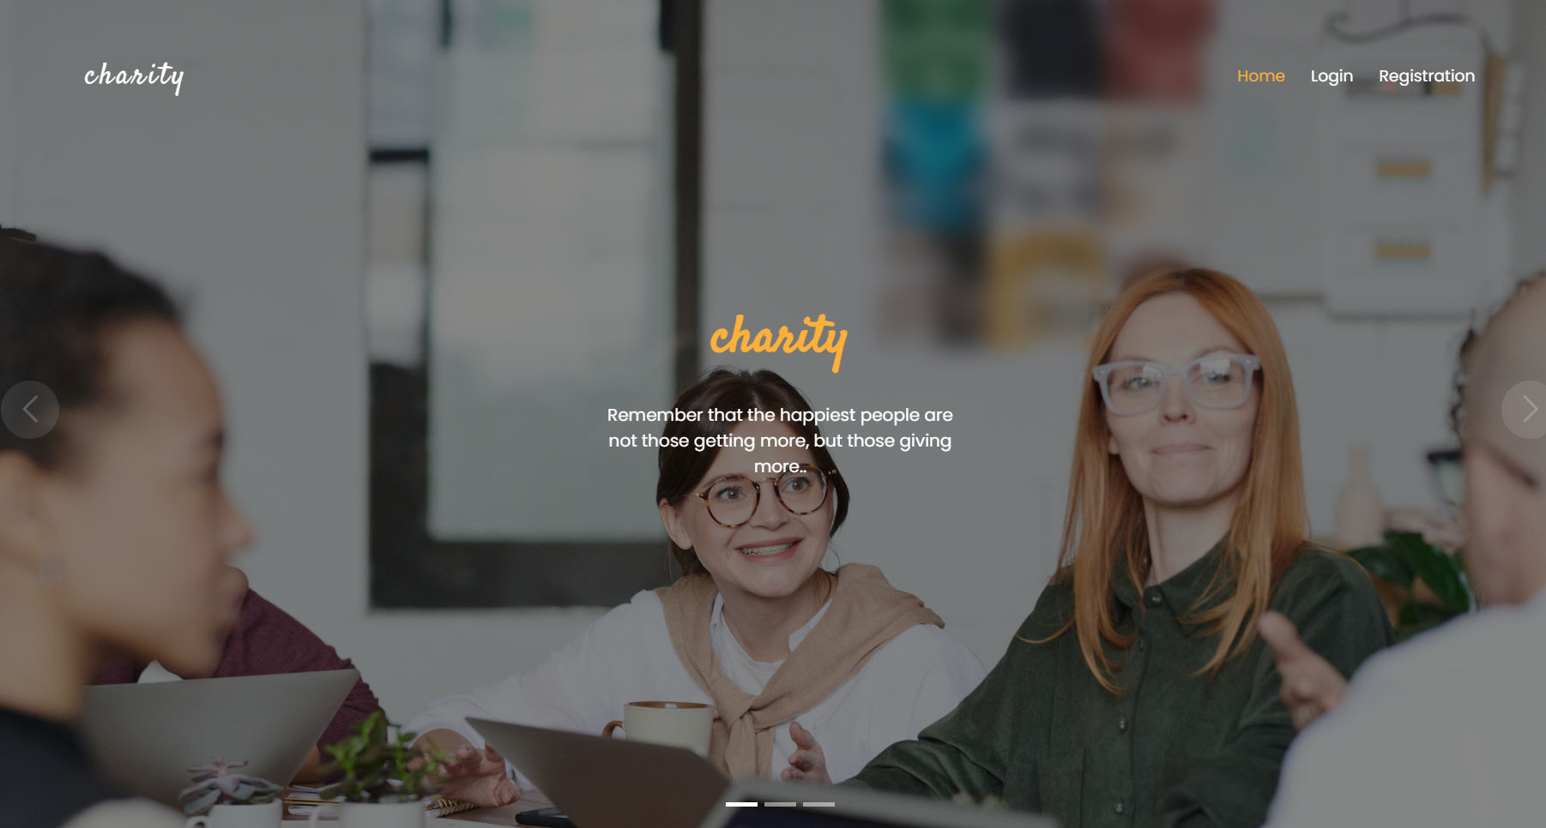
Screenshots

Slide 12

THANK YOU
THANK YOU

Slide 13
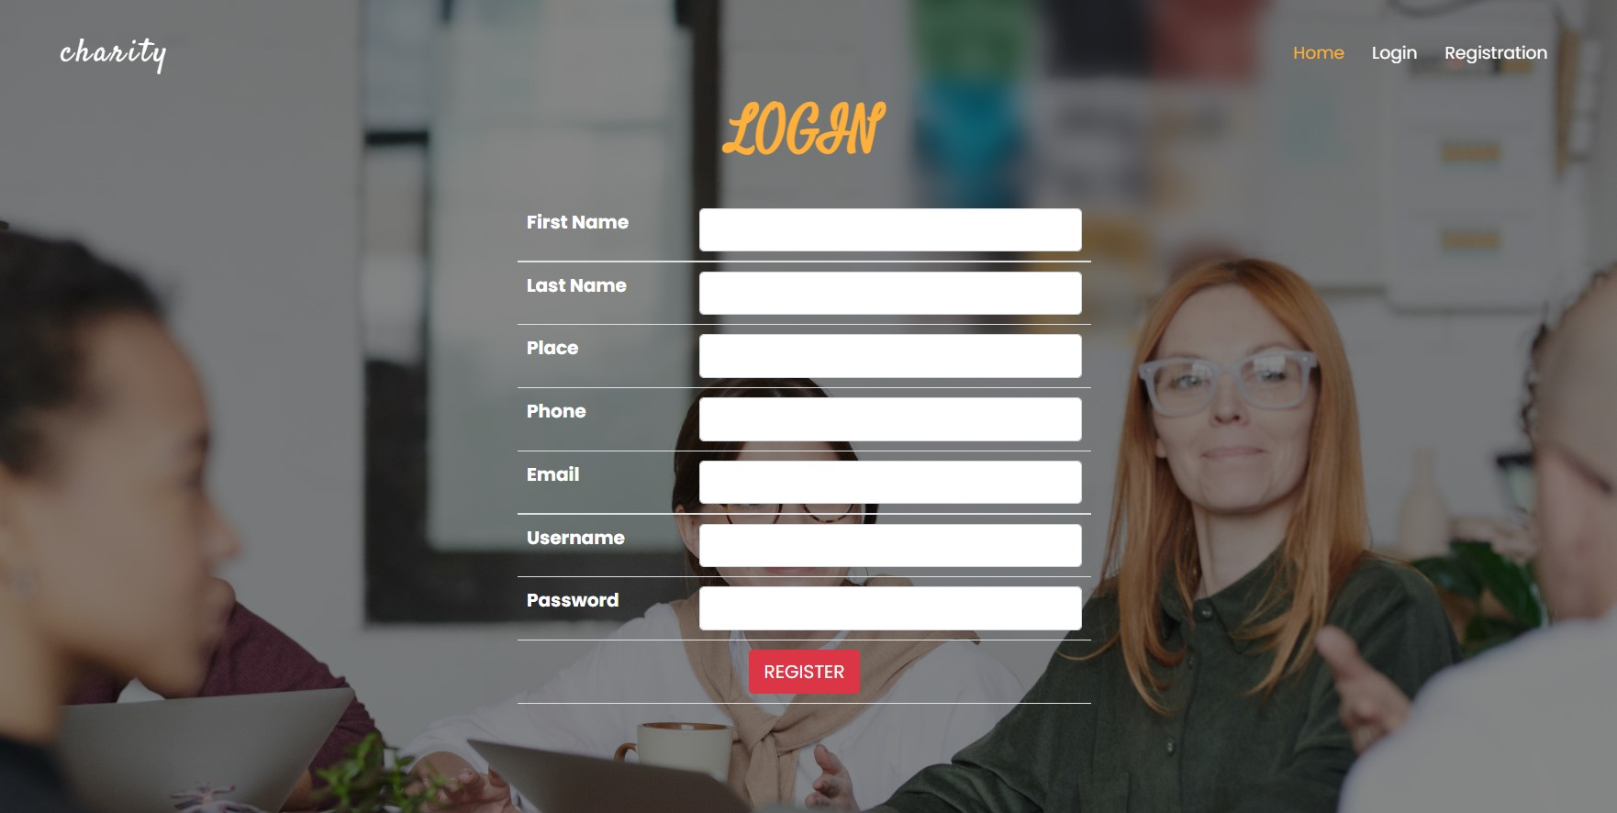

Slide 14


Slide 15
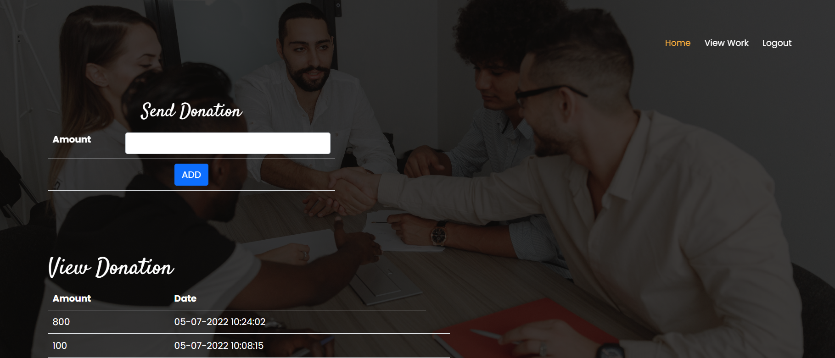

Slide 16
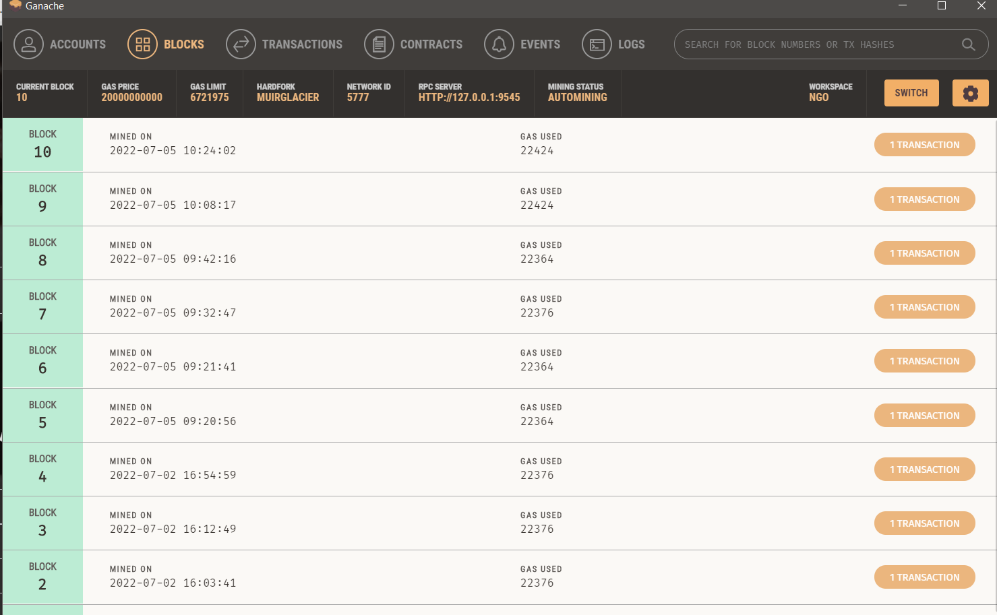

Slide 17
THANKYOU
THANK YOU

